Slide 1

U.S. Stock Pickers
Project Team 3
Iteration 3 / Final Presentation

Slide 2
Team Members
Member | Role
Sylvie Xiang | Team Leader
Duy Nguyen | QA Leader
Serguei Chervachidze | Design & Implementation Leader
Jing Tian | Configuration Leader

Slide 3
Iteration 3 Overview
Unit Test
Added unit test for configuration file and forecast feature
Integration Test:
Modified test code to able to run all tests and handle free API account limitations
MFA Survey Results
A SurveyMonkey was developed and sent out to friends and family of Group3. Results were gathered and summarized as a performance indicator for the StockPickers project.

Slide 4
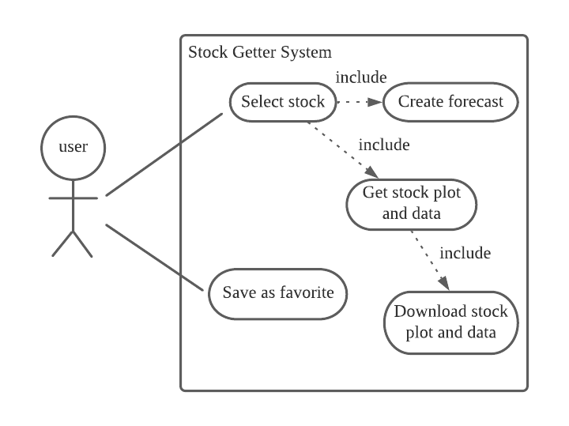
Requirement Analysis Overview
Use case diagram:

Slide 5
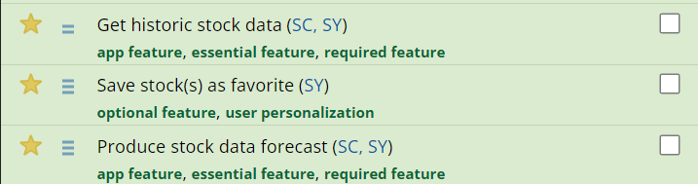
Requirement Analysis
Requirement Trackers:
SPPP “Proposed High level Requirements”
Pivotal Tracker: user stories

Slide 6
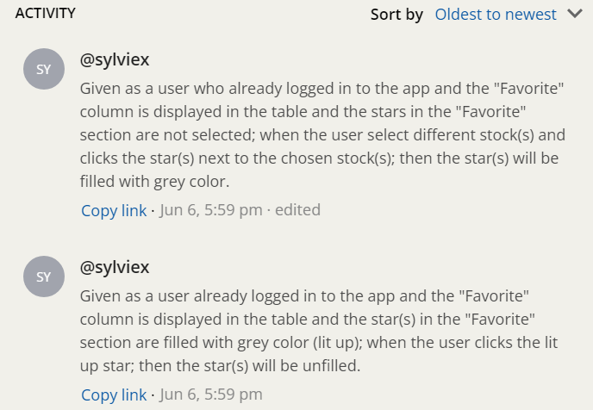
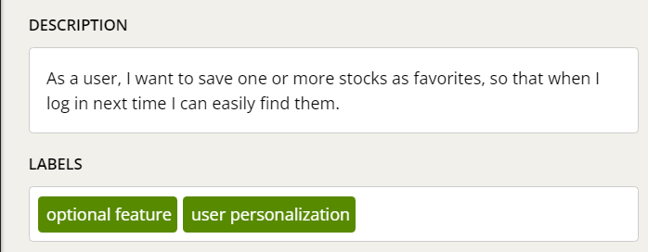
Requirement Analysis
User story example:

Slide 7
Requirement Analysis
Total User Story Points Accomplished: 11 out of 11 essential story points finished
Accomplished essential features:
Obtain historical stock price data
Forecast stock prices
Display stock data in plots
Display data for multiple stocks
Download stock data to local machines
Download data for multiple stocks
Accomplished optional feature:
Save stocks as customer’s favorites on site

Slide 8
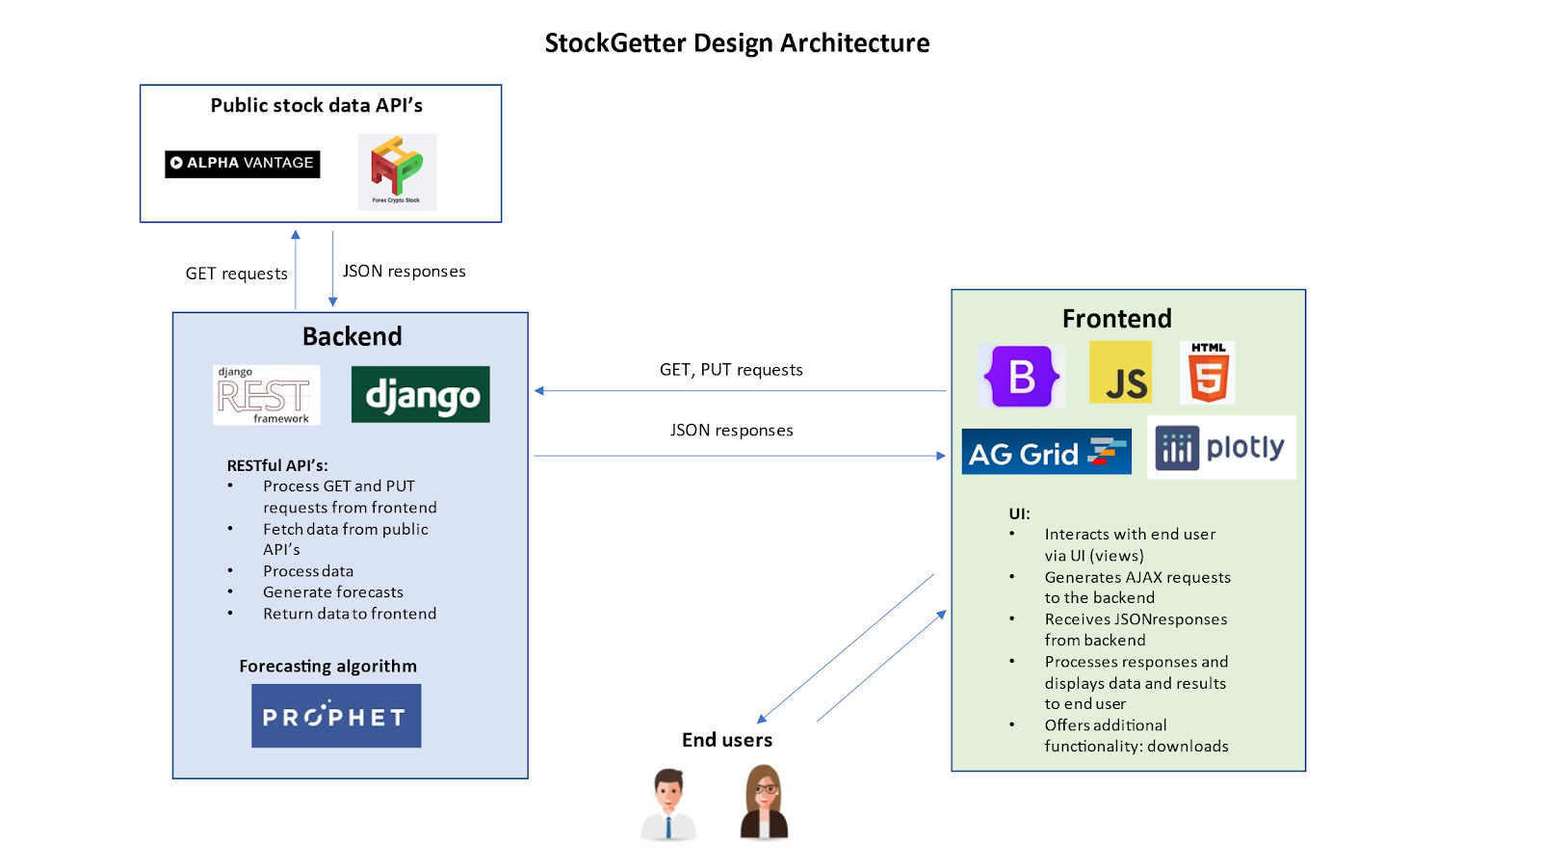
Design

Slide 9
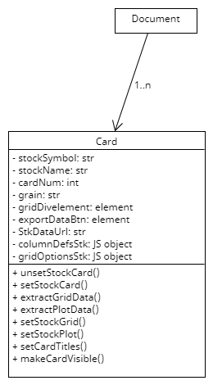
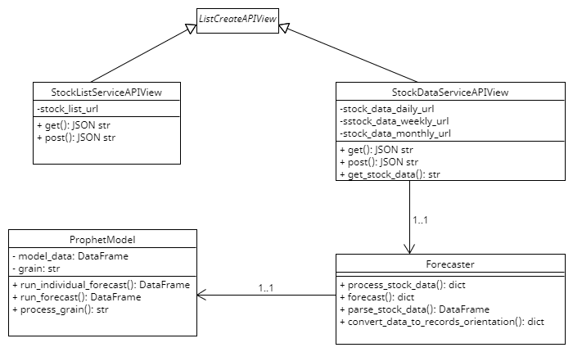
Design
Frontend & Backend Class Diagrams

Slide 10

Implementation
Toolset:
Use IDE tools (VsCode and PyCharm with debuggers):
Linters (pep8, pylance, pylint)
Debuggers
Automated testing tools
Virtual environments for Python to isolate dependencies
Front end in JS (VsCode tools)
Backend in Python (Django)
Frontend and backend run on localhost with different ports
Implementation philosophy:
Effectively use OOP to implement design specifications
Implementation reuse via OOP (e.g. we wrap Facebook Prophet algorithm)
Future-proof/modular/scalable design
Classes implemented with extensibility in mind:
(e.g. Forecaster class supports multiple forecast model types; for now implement Prophet only, but can be easily extended)

Slide 11
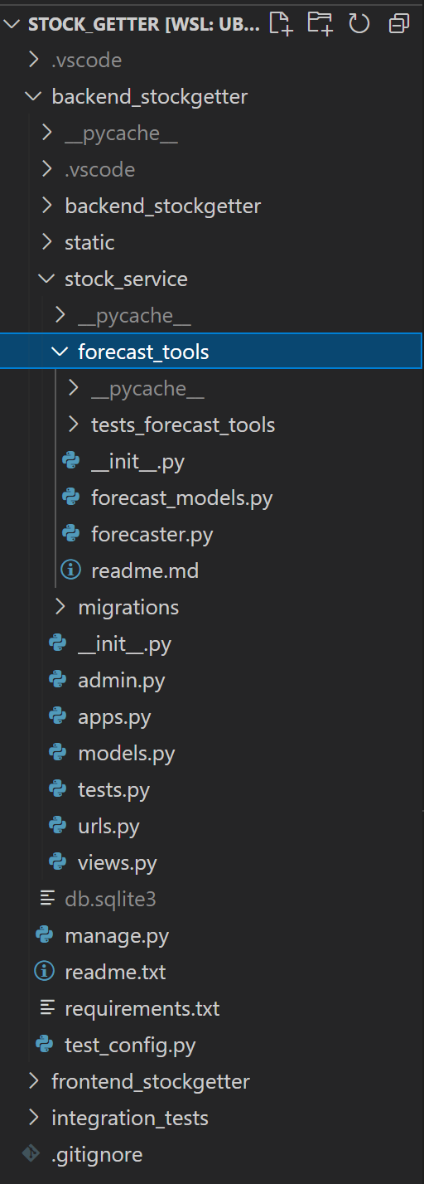
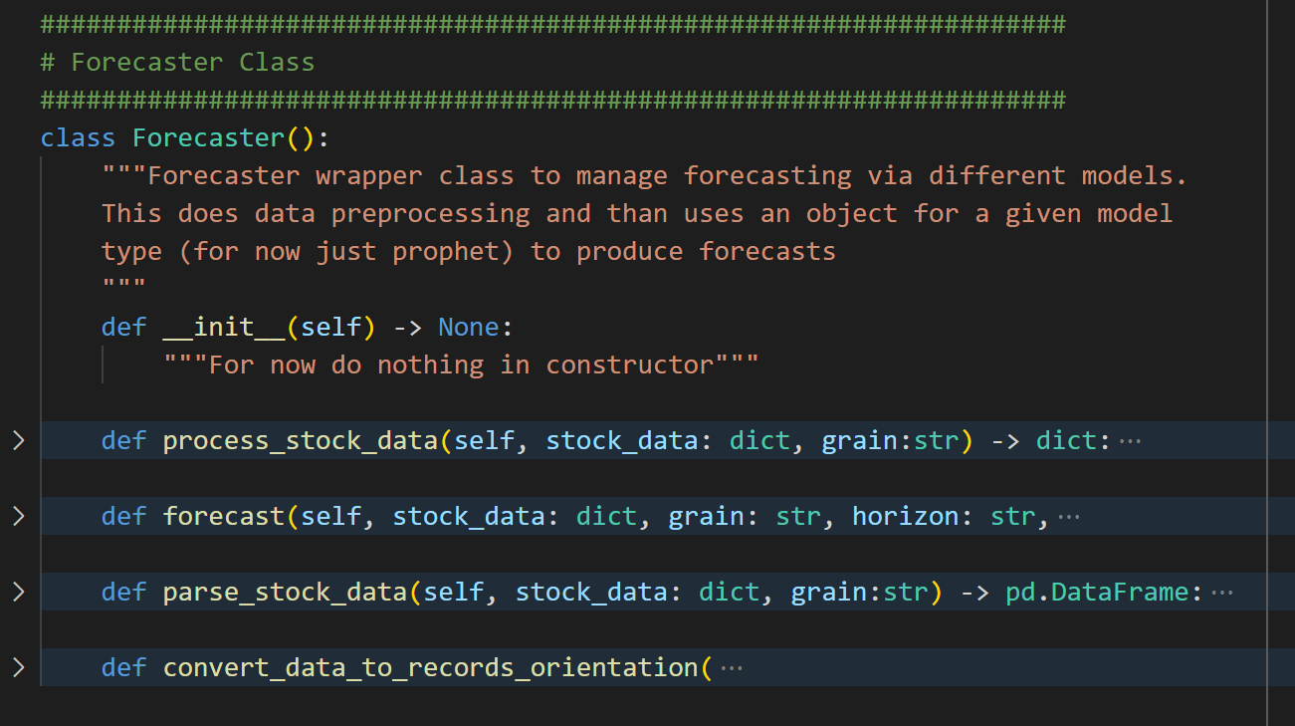
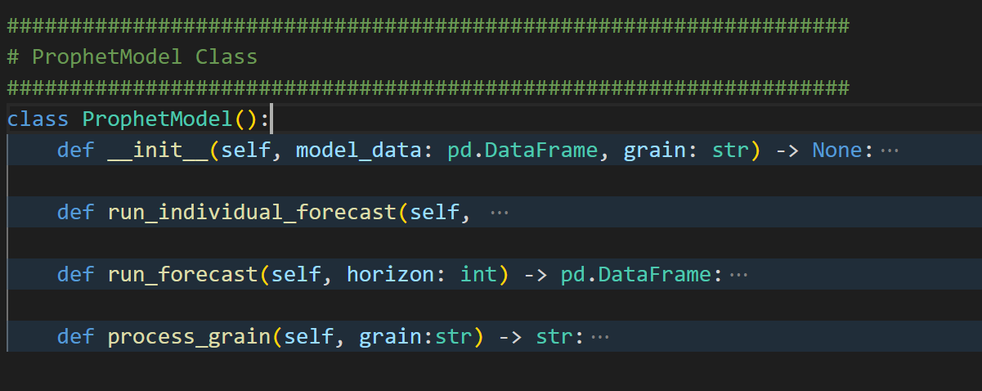
Implementation

Slide 12
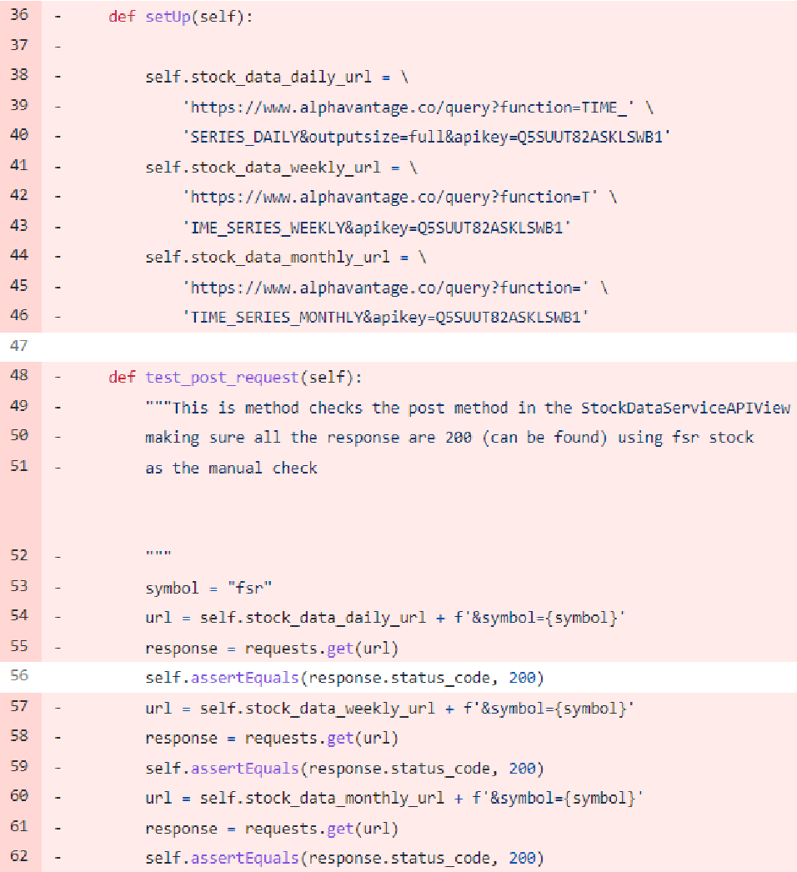
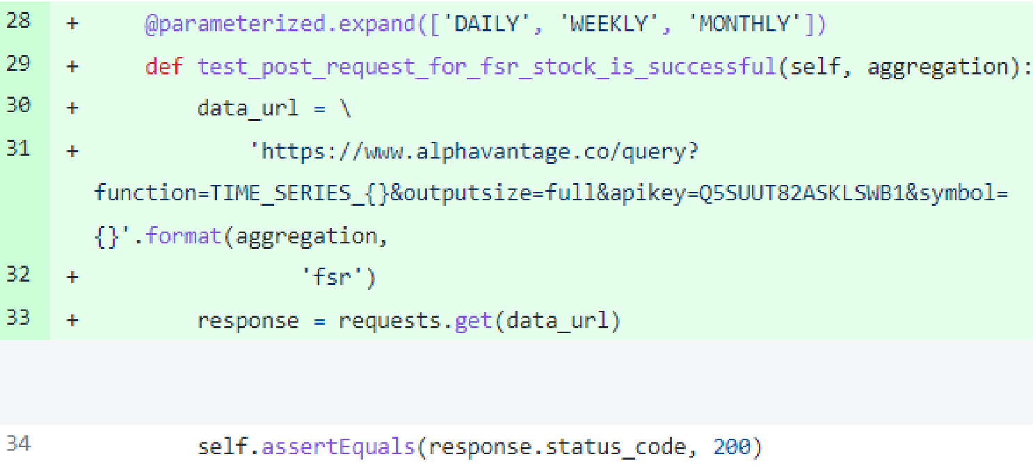
Implementation Refactoring Example
2. Refactoring
Example:

Slide 13
Testing Overview
Manual Test - Manual manipulations and interactions with app
Unit Test - Uses Django’s TestCase framework for backend testings and uses Vitest framework for Javascript front end testing
Integration Test - Utilizes Selenium webdriver to automatically test key features.

Slide 14
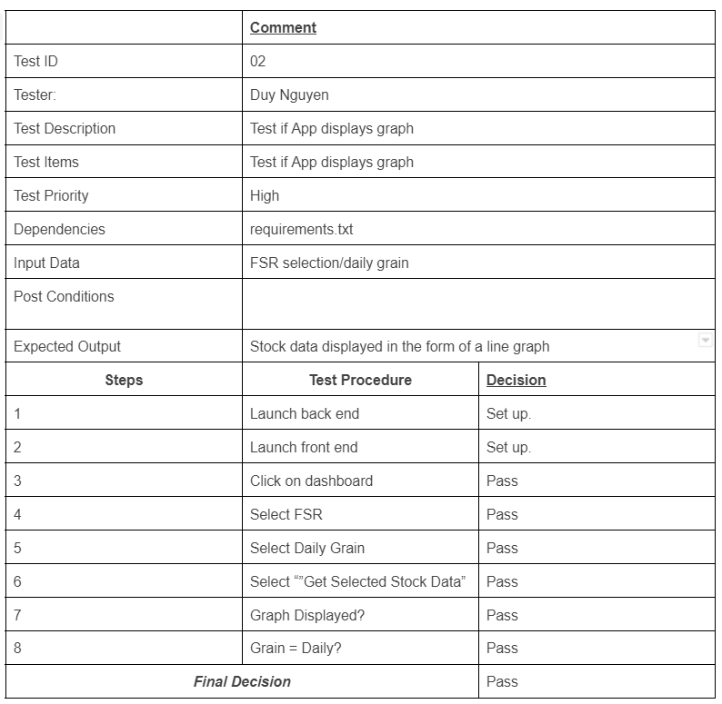
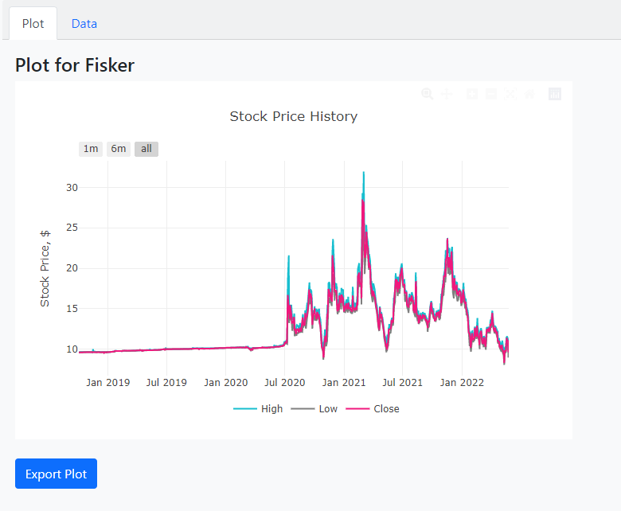
Testing
Manual Test Example:

Slide 15
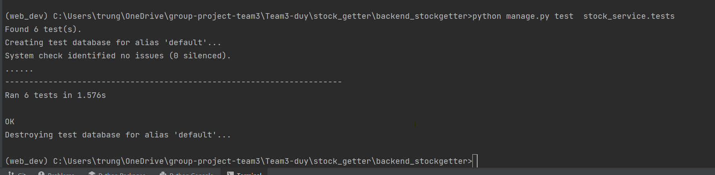
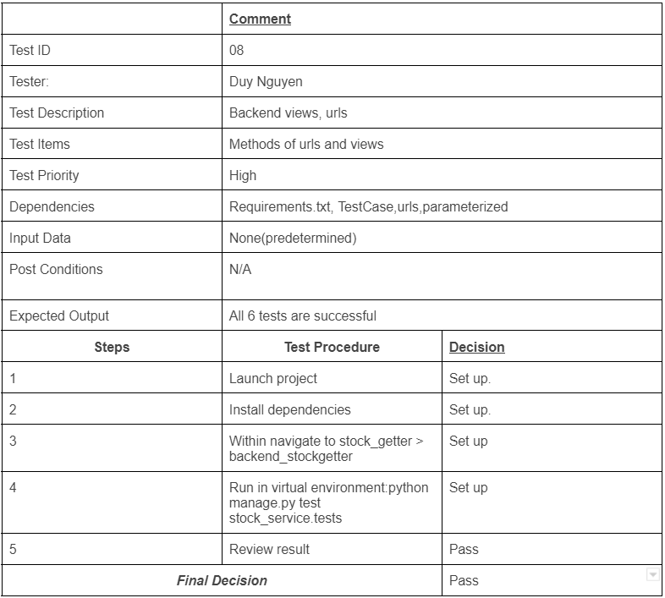
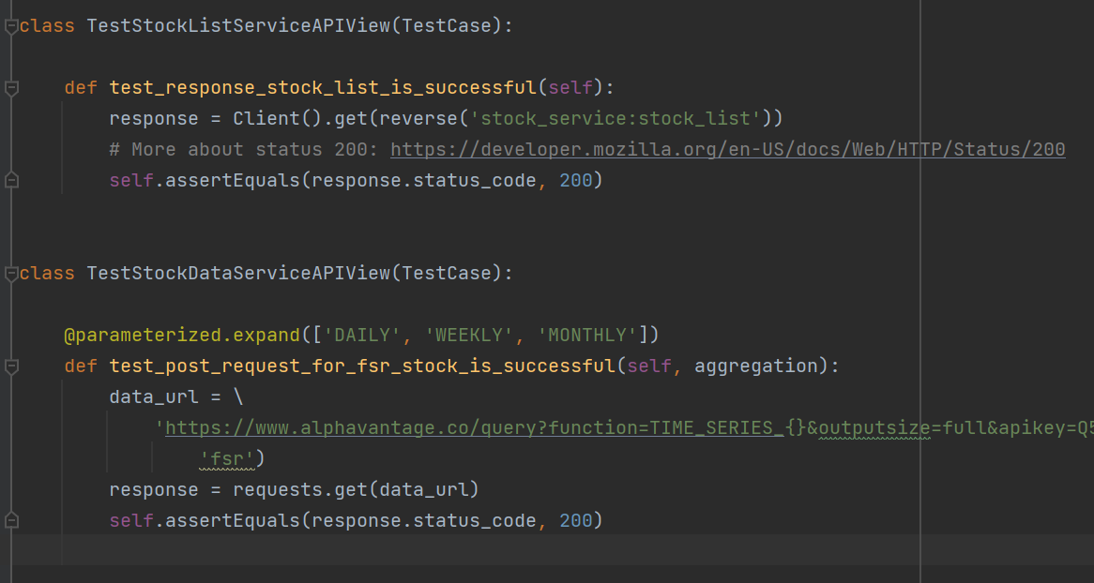
Testing
Unit Test Example:

Slide 16
Testing
Integration tests
All features: graph, forecast, save as favorite
Technique: Selenium Webdriver, NodeJS
Impact: made sure all of our code features work as intended and there is no regression

Slide 17
Project Management
Achievements: all essential features and additional optional feature
Challenges
Not familiar with tools such as PivotalTracker, Django, Facebook Prophet
API key limitation
Low level of familiarity with Javascript prevented from bigger coverage of unit test for front end
Learned Objects
- Tools: Pivotal Tracker, Django, Github
- Agile methodology
- UML diagrams: Use Case and Class Diagrams
- Testing techniques: Selenium, unit testing
- ML algorithm - Facebook Prophet

Slide 18
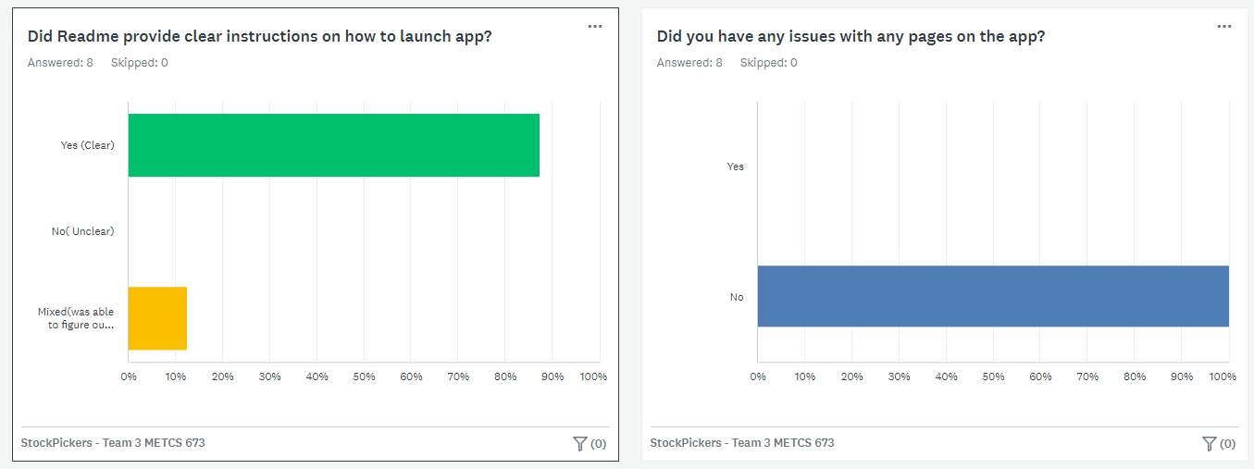
Project Management
Quality Metrics
Total personal hours: 201.5
Customer Rating:Metrics(KPI’s)

Slide 19
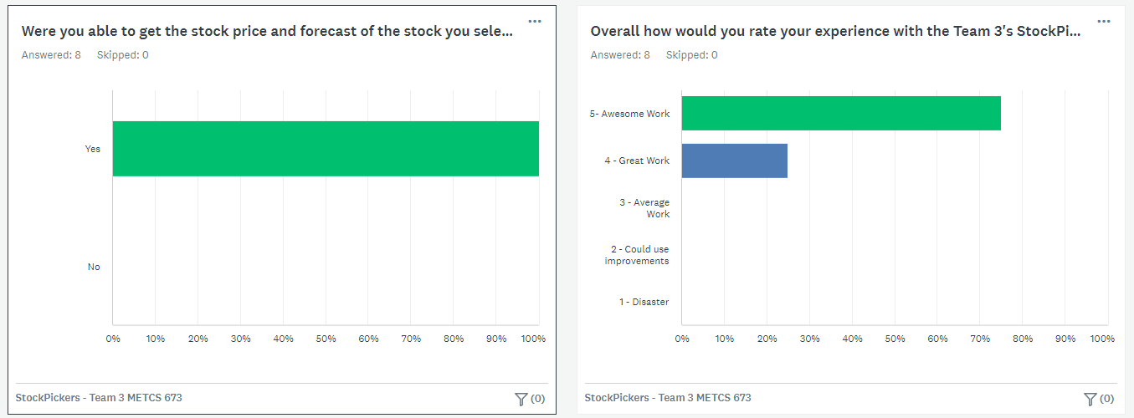
Project Management

Slide 20
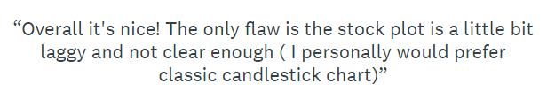
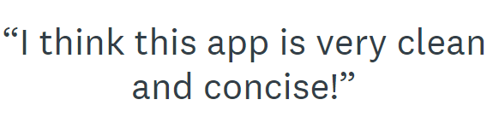
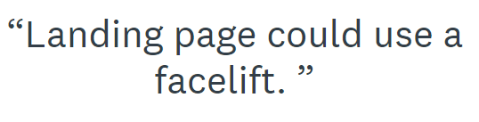
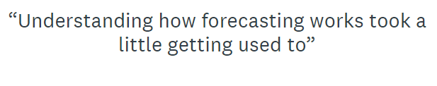
Metrics(KPI’s)

Slide 21
Thank you !

